Slide 1
Mantid Release Presentation
Release 2.6
ISIS

Slide 2
What is this meeting
Release 2.6
Timeline
Present the changes and improvements
Focus on Curve Fitting and Optimisation
What’s coming next
Questions
I didn’t catch what you meant – ask immediately
I’d like to add something – at the end of each section
I wish it did this – Talk to the developer at the end

Slide 3
Release Timeline
July 29th
Aug 1st
Aug 2nd
Developer Testing
Final Fixes
Beta Testing
Release
Release
Presentation

Slide 4
New team members
Samuel L. Jackson – Indirect Inelsatic
Arturs Bekasovs – Muon
Jay Rainey – ICAT
Keith Brown – Framework Internals

Slide 5

Installation
Change to the location of user preferences
Window placements
Last entries on algorithm dialog boxes
Migrated on exit of first run of Mantidplot
So Install -> Run -> Close -> Run again ->

Slide 6
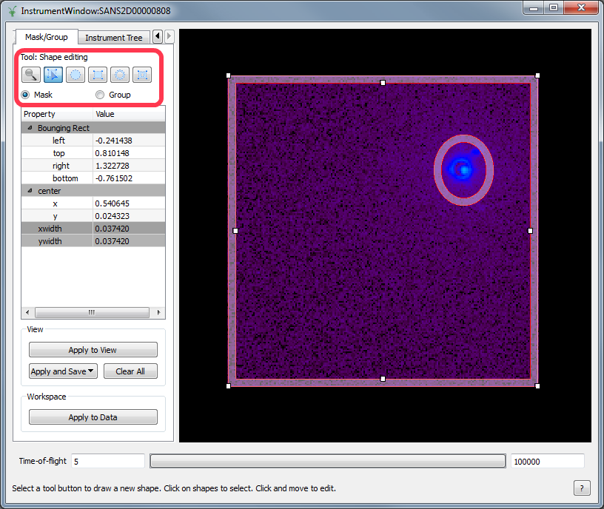
Mask, Group and Pick share shape tools

Slide 7
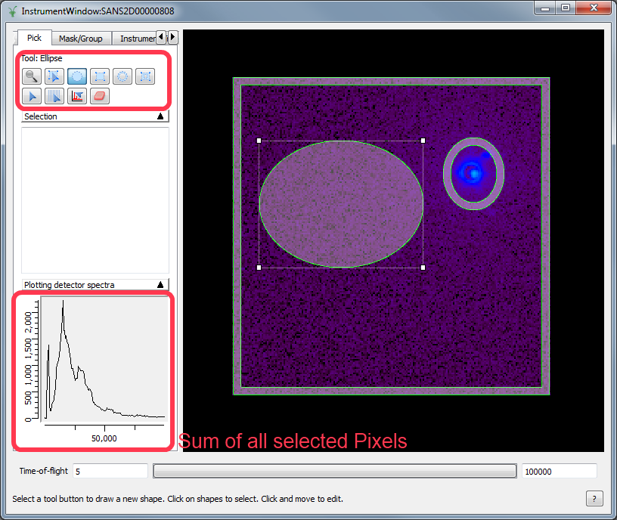
Pick Mode adds more & sums selections

Slide 8
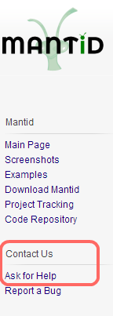
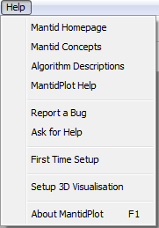
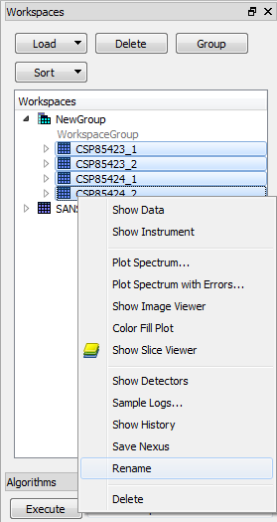
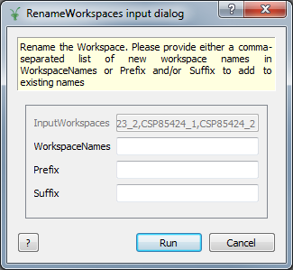
User Interface
Asking For Help
New option added to web page and help menu
Renaming Lists of workspaces

Slide 9
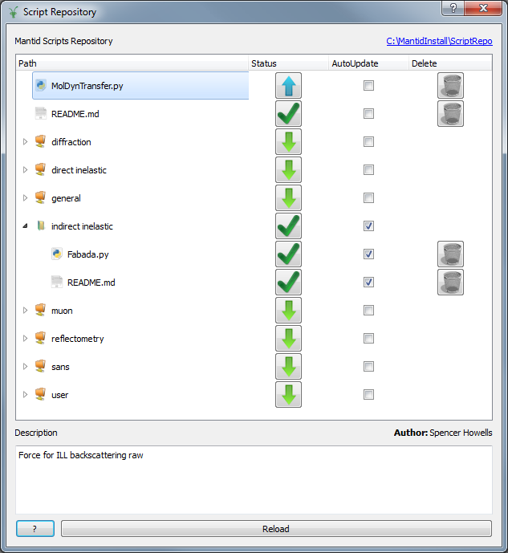
User Interface
Script Repository
Delete
Only for Author
AutoUpdate
Downloaded on startup
Paths set up automatically

Slide 10
Python API retirement
Need to retire v1 “from mantidsimple”
All Scripts need to move to v2 “from mantid.simpleapi”
Timeline
Release 2.5 (May)
Both APIs work
Script default is v2
Release 2.6 (Aug)
Both APIs work
Deprecation warning for v1
Release 3.0 (Nov)
v2 only works
v1 removed

Slide 11
Python API retirement
How do I update my scripts?
Upload the scripts to the script repository before 30th June.
Try migrate1to2.py
Look here http://download.mantidproject.org/docs/current-release/python/html/changes.html
Contact the Dev Team

Slide 12
Tube Calibration
Example files: C:\MantidInstall\scripts\Calibration\Examples
Wiki link: http://www.mantidproject.org/Tube_Calibration

Slide 13
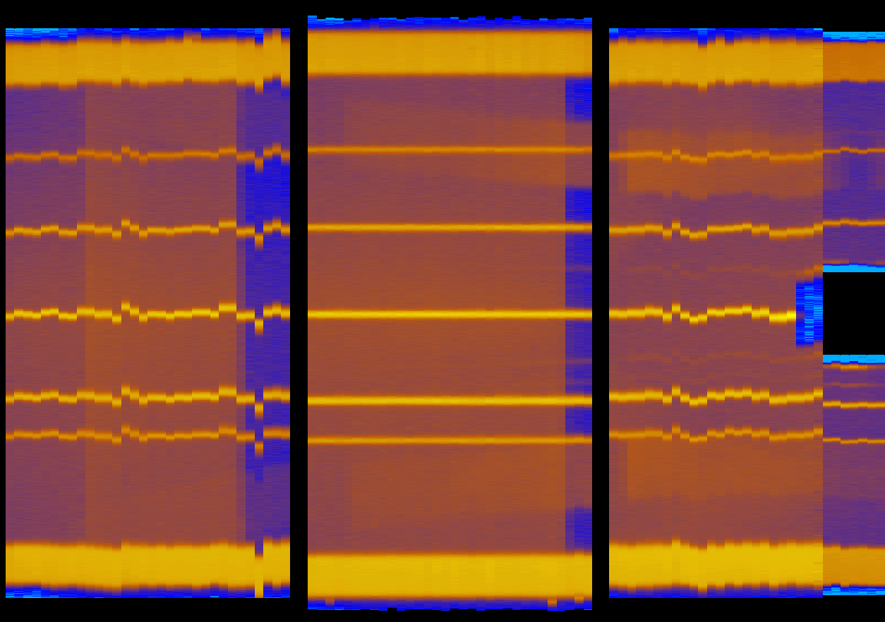
MERLIN Calibration Demonstration

Slide 14
Python – Other Improvements
Progress within Python algorithms
Increased control from Python:
Instrument View: See Instrument View docs on wiki
Workspace axis units: Can have arbitrary labels

Slide 15
Single Crystal Diffraction
Mantid 2.5

Slide 16
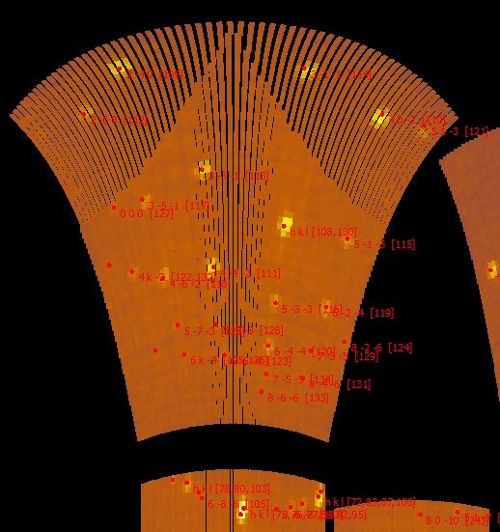
Benchmarking and Improvement
Does the workflow work with real ISIS data?
How can I tune the workflow better on my instrument?
What if the workflow breaks?

Slide 17

What’s coming in v3.0
ISIS
Live event data reduction
Automatic Reduction
Training courses
Introduction to Mantid
Introduction to Python
Python in Mantid
Extending Mantid using Python
Support for ICAT 4
No more support for Python API v1
Various technique led improvements

Slide 18

Thank you

